Slide 1
Place of Occurrence
Q6Crime by place of occurrence.
Query:-
SELECT States,
SUM(RESIDENTIALPREMISES_Burglary+RESIDENTIALPREMISES_Dacoity+RESIDENTIALPREMISES_Robbery+RESIDENTIALPREMISES_Theft) AS RESIDENTIAL_AREA,
SUM(HIGHWAYS_Burglary+HIGHWAYS_Dacoity+HIGHWAYS_Robbery+HIGHWAYS_Theft) AS HIGHWAYS_AREA,
SUM(RIVERandSEA_Burglary+RIVERandSEA_Dacoity+RIVERandSEA_Robbery+RIVERandSEA_Theft) AS RIVER_SEA_AREA,
SUM(RAILWAYS_Burglary+RAILWAYS_Dacoity+RAILWAYS_Robbery+RAILWAYS_Theft) AS RAILWAYS_AREA,
SUM(BANKS_Burglary+BANKS_Dacoity+BANKS_Robbery+BANKS_Theft) AS BANKS_AREA,
SUM(COMMERCIALESTABLISHMENTS_Burglary+COMMERCIALESTABLISHMENTS_Dacoity+COMMERCIALESTABLISHMENTS_Robbery+COMMERCIALESTABLISHMENTS_Theft) AS COMMERCIALS_AREA,
SUM(OTHERPLACES_Burglary+OTHERPLACES_Dacoity+OTHERPLACES_Robbery+OTHERPLACES_Theft) AS OTHERPLACES_AREA
FROM "17_Crime_by_place_of_occurrence_2001_2012"
WHERE States NOT LIKE "%TOTAL%"
GROUP BY States;

Slide 2
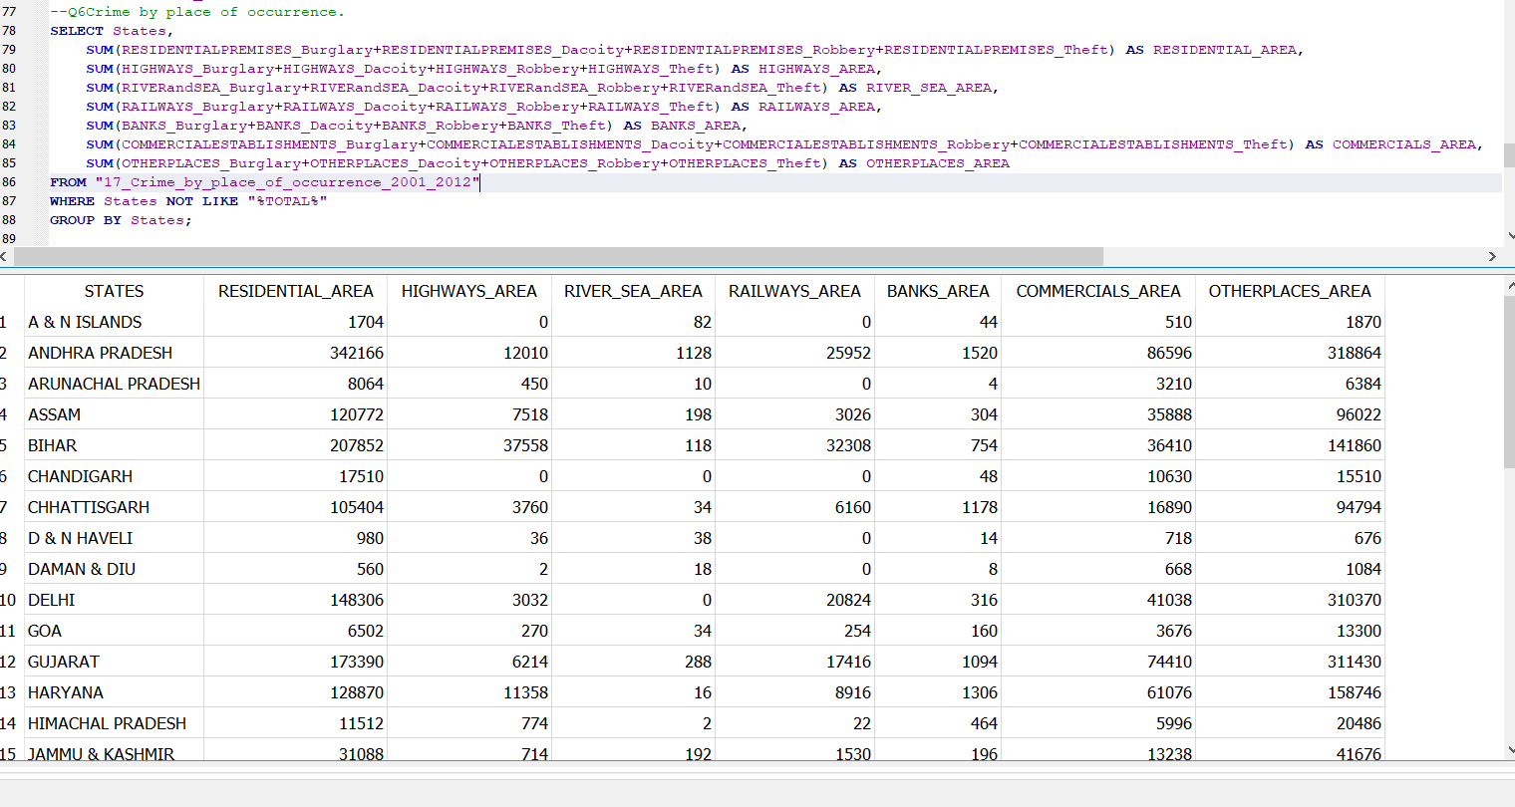
Our query screenshot:-

Slide 3
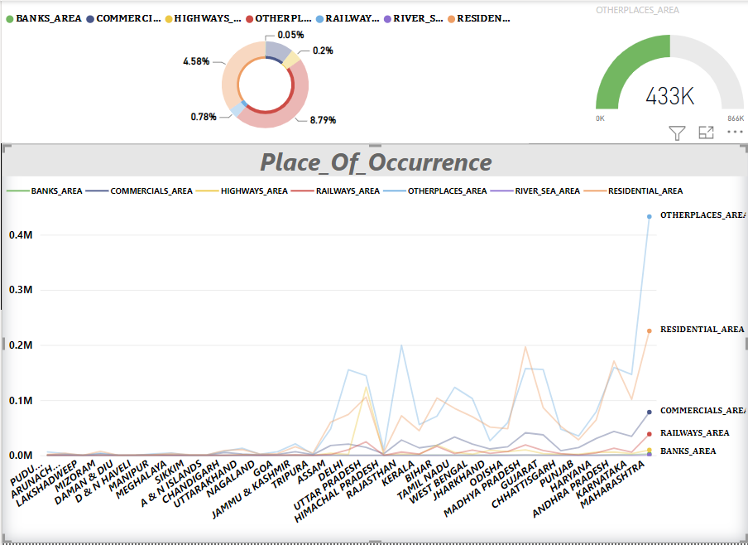
Conclusion:- 1. ﻿MAHARASHTRA had 2570 BANKS_AREA, 78355 COMMERCIALS_AREA, and 9731 HIGHWAYS_AREA.

